Slide 1
Externalities and Public Goods
Chicago Price Theory

Slide 2
Externality?
“Externalities refers to situations when the effect of production or consumption of goods and services imposes costs or benefits on others which are not reflected in the prices charged for the goods and services being provided.”
  Quote from OECD
Image credit: clipart.email

Slide 3
Externality?
“Externalities refers to situations when the effect of production or consumption of goods and services imposes costs or benefits on others which are not reflected in the prices charged for the goods and services being provided.”
  Quote from OECD
  Prices are the fundamental concept for understanding externalities and
  why public policy has sometimes made externalities worse.

Slide 4
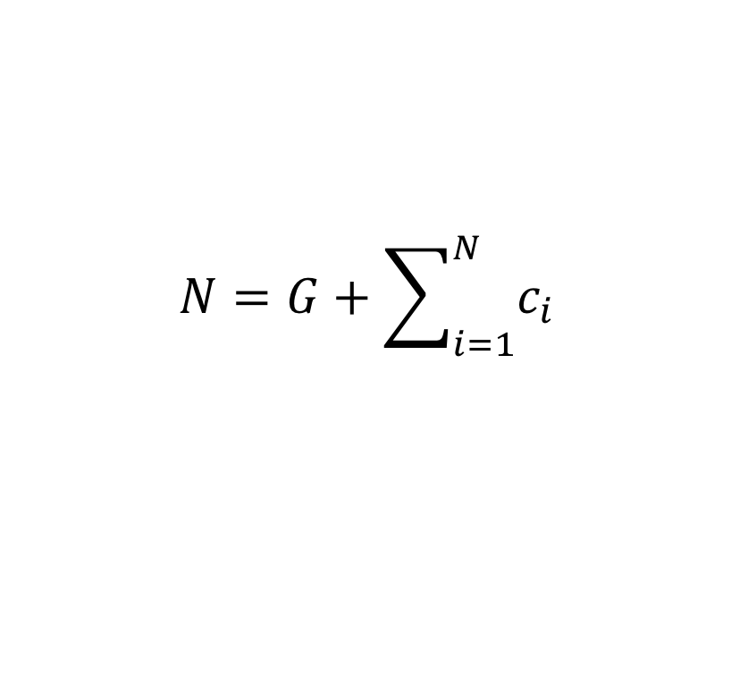

Public Goods
Symmetric special case of positive externalities
  Everyone receives the same externality
E.g., aggregate endowment can be allocated between private and public goods.
  Nonexcludable because G is common across consumers
  Nonrival because the price of G is independent of N.
  Contributions to the public good have a positive externality
$$N=G+\sum_{i=1}^{N}{c_{i}}$$
$$u_{1}\left(c_{1},G\right),u_{2}\left(c_{2},G\right),…u_{N}\left(c_{N},G\right)$$

Slide 5
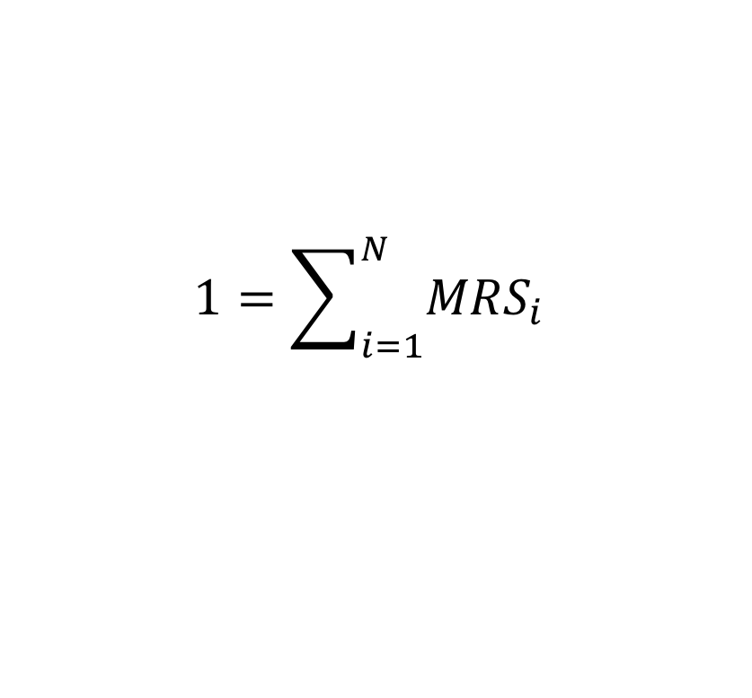

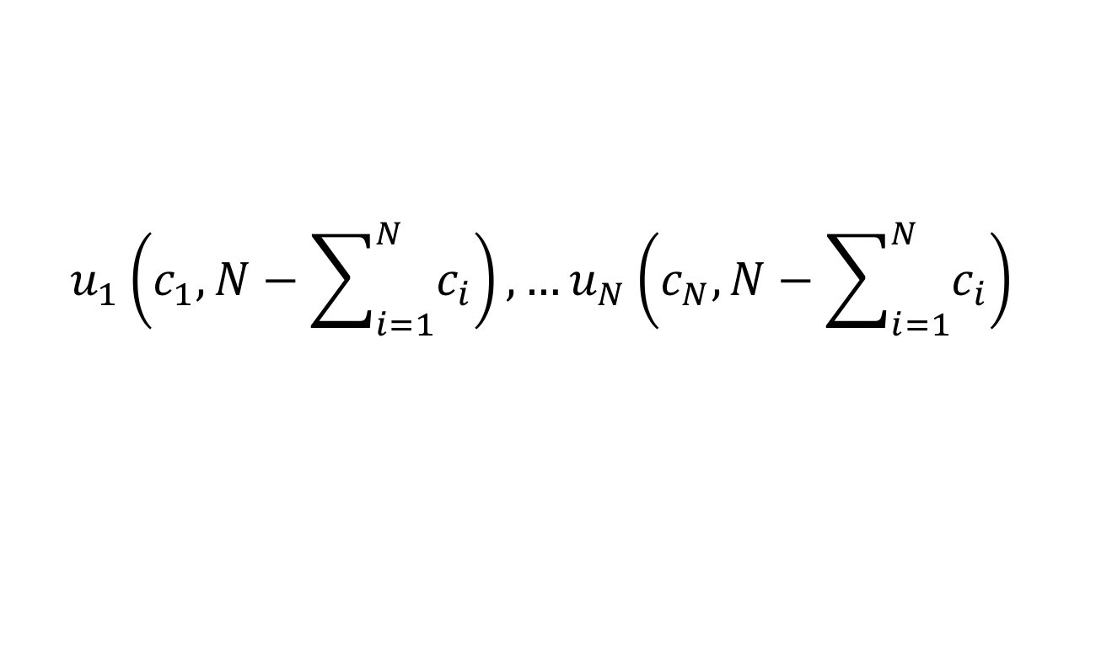
Public Goods: Pareto Efficiency
MC = sum of individual WTP’s
  i.e., without income effects sum demand curves vertically
  “Samuelson condition for collective consumption good”
Special case: identical consumers
$$u_{1}\left(c_{1},N−\sum_{i=1}^{N}{c_{i}}\right), …u_{N}\left(c_{N},N−\sum_{i=1}^{N}{c_{i}}\right)$$
$$1=\sum_{i=1}^{N}{{MRS}_{i}}$$
$$\frac{1}{N}=MRS$$

Slide 6

Public Goods: Nash Equilibrium in Contributions
MC = WTP
  Low WTP consumers will not contribute
Special case: identical consumers
$$1≥MRS_{i}$$
$$1=MRS$$

Slide 7




Figure 1. Pure public good allocations with constant MC
p
Average demand
D
Noncooperative supply
$$1$$
Several neutrality results, e.g., with respect to N
Social MC
E
1/N
Public good
quantity
0
$${\frac{N−1}{N}G}_{D}$$
$$G_{D}$$
$$G_{E}$$

Slide 8
Public Goods: Supply from Voluntary Associations
Group WTP is the sum of MRS among M < N members only
  E.g., might enforce matching contributions
  May supply nearly the efficient quantity
  Even better if some excludability. Infectious disease!
Group acts like an individual with WTP scaled up, or MC scaled down, by M
  The other N – M unilateral actors may contribute nothing
  i.e., the unilateral actors will free ride

Slide 9


Figure 1. Pure public good allocations with constant MC
p
Average demand
D
Nongroup supply
$$1$$
F
Group supply
$$1/M$$
Free-ride benefit
(nonmembers skip contribution)
Social MC
E
1/N
Public good
quantity
0
$$G_{D}$$
$$G_{F}$$
$$G_{E}$$

Slide 10
Public Goods: Supply from Voluntary Associations
Group WTP is the sum of MRS among M < N members only
  E.g., might enforce matching contributions
  May supply nearly the efficient quantity
  Even better if some excludability. Infectious disease!
Group acts like an individual with WTP scaled up, or MC scaled down, by M
  The other N – M unilateral actors may contribute nothing
  i.e., the unilateral actors will free ride
“the business enterprise … made possible more elaborate specialization and machinery, more perfect coordination of effort and greater reduction of waste than could be attained by the family.”

Slide 11
The Core
Any feasible allocation that cannot be improved upon by any coalition
  Coalition: a subset of agents take their endowment and allocate it among themselves
  “Cooperative game theory”
  2^{N}–2 possible coalitions: not (centrally) computable!
Group supply of a pure public good may not be in the core unless
  The group generates surplus for another reason, or
  Nonmembers can be excluded from at least part of the benefits of member contributions
    “club goods”
    Are pure public goods uncommon?

Slide 12
The Coase Theorem
“In the absence of transactions and bargaining costs, affected parties to an externality will agree on an allocation of resources that is both Pareto optimal and independent of any prior assignment of property rights” (Mueller 1989, p. 28)
i.e., beginning from an inefficient allocation, parties have an incentive to improve via cooperation
  Esp., parties with much to gain
  Murphy on the single-price monopolist
Public policy is misguided if it ignores equilibrium cooperation
  Esp., if “corrective” policy makes cooperation more difficult. Infectious disease, again.

Slide 13
Fighting Infectious Disease at Work
60-70 percent of employers offer on-site flu shot
  Among employed persons, the workplace is the most common place to receive it (doctor office close second)
  Hardly any self-employed (= small business?) receive at work
  Self employed much less likely to vax than employees
61 percent of workers have paid sick leave
  50 percent at small businesses (< 50)
  81 percent at large businesses (>499)
The firm-size gradient: scale economies in provision? accumulated MRS (Samuelson)? Disease severity?

Slide 14
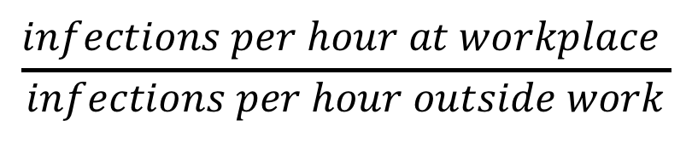
$$\frac{infections per hour at workplace }{infections per hour outside work}$$

Slide 15
Externalities in Centrally-Planned Economies
Central planning/management did not alleviate externalities
  Much pollution
  Lack of a reliable price system makes externalities worse
  Each seller “tends to neglect the requirements of the user, and finds that it is actually beneficial to do so.”
Source: Nove, Alec. “Socialism and the Soviet Experience.” in The Economics of Feasible Socialism Revisited.
“Externalities refers to situations when the effect of production or consumption of goods and services imposes costs or benefits on others which are not reflected in the prices charged for the goods and services being provided.”
  Quote from OECD

